Slide 1
HOSTEL MANAGEMENT SYSTEM
(HMS)
Software Engineering Project
By - Omang Rawat (1901126)
Rahul Soni (1901154)
Vaibhav Kesarwani (1901212)
Vishesh Sharma (1901217)

Slide 2
INTRODUCTION
The purpose of developing this “Hostel Management System” is to keep the students and the hostel administration connected through a virtual platform rather than maintaining records manually using registers.
It will integrate the benefits of better organizability with effortless accessibility leading to an increased efficiency for the workforce and convenience for all.

Slide 3
The project has been implemented as an individualistic yet a well-knit system to provide unique functionalities for every different type of users while keeping the integrity of the hostel held closely.
This small piece of software can help in creating systematic and structured records leading to a coherent use of the information.
It can later be used in other institutes too.

Slide 4
SHORT OVERVIEW
Login Interface: Interface for students, warden / caretaker, guards / cleaning services to login onto the virtual platform.
Dashboard Updates: Notification window where warden / caretaker / guards can post some hostel regarding updates.
Record Storage: Keeping a centralized database which would be maintained via the online system
Managing courier / deliveries
Managing room related issues
Managing sports equipments
Managing hostel cleaning issues
Authentication: Restricted authentication for only institute employees and students
Administration Access: Administration would be able to keep an eye on the records of students

Slide 5
FUNCTIONAL REQUIREMENTS
Users must have a valid User ID and password to login thus having their individual profiles.
Wardens can register new students and update any existing records.
Students can check for the status of their deliveries with hostel guards.
Students can inform if room cleaning services are required.
Guards can update the status ( receive / submit ) of sports equipment.
Dashboard for any notices or updates from wardens and guards.
Students can send queries regarding any hostel issues to the associated administration.
Caretakers can register new guards and cleaning staff.
Cleaning staff can keep track of the cleaning requests, accept and handle them accordingly.

Slide 6
NON-FUNCTIONAL REQUIREMENTS
Requirements specifying criteria that can be used to judge the operation of a system are called non-functional requirements. For our system, they are as follows:
Secure access of any confidential data
Round-the-clock-service availability
Better component design to get efficiency at peak time
Flexible service based architecture ( MVC pattern ) will be highly desirable for future extension.
CRUD implementation and limited accessibility for users according to their respective roles.

Slide 7
Logic Implementation

Slide 8
ROLE DISTRIBUTION
We basically have 5 different types of users who can log in through our login page and thus get directed to their respective home pages as per the roles they have been assigned.
We have divided the roles as :
Student
Guard
Cleaning Service
Caretaker
Warden
which can be viewed in the database as numbers from 1-5 respectively to keep the naming of the roles more dynamic and keep the database more independent.

Slide 9
LOGIN PAGE
To handle the information of every role we have a different collection set in the database (caretakers, employees, guards, students, wardens) so that data about every user would be more easily accessible and cleanly assembled.
The page fetches UID and role from the documents according to the email and directs them to their respective home pages accordingly.
The functionalities of each user have been developed according to their respective authority and the work they do.

Slide 10
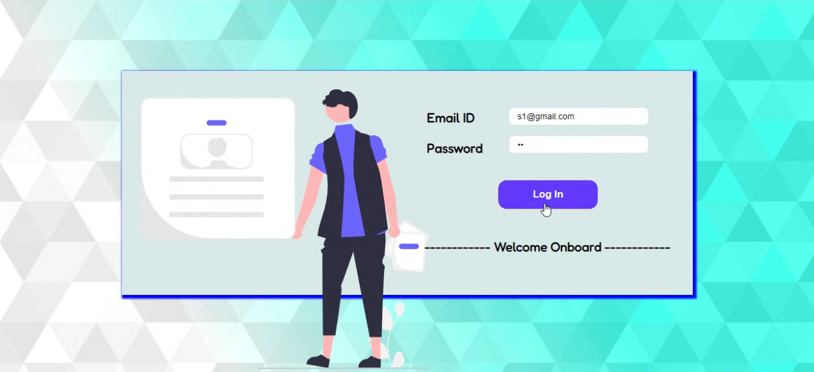

Slide 11
STUDENT INTERFACE
Home Page
Profile - Every student can view their homepage which holds all the personal information about themselves that the database holds which is fetched via API call to the “students” table in the database with UID as a primary key.
Cleaning Request - A student can request cleaning of their rooms with a click of a button, which sends a direct request to the cleaning service which is handled by sending the UID of the student as the sender’s ID and the room no. of the student to the “requests” table as cleaning request in the DB.

Slide 12
Room Query - Students can also put any other queries or complaints from the homepage which are added to the request table by similarly sending the sender’s id and room no. which can be viewed by the guards.
Sports Equipment Request - Students can request any sports equipment, the POST request with equipment, student UID is sent to guards and saved in the “sports” collection in DB.
Noticeboard
Students have access to the dashboard where they can get any important notices that might have been posted by Warden or Caretaker which are fetched from the “notifies” collection in DB.

Slide 13
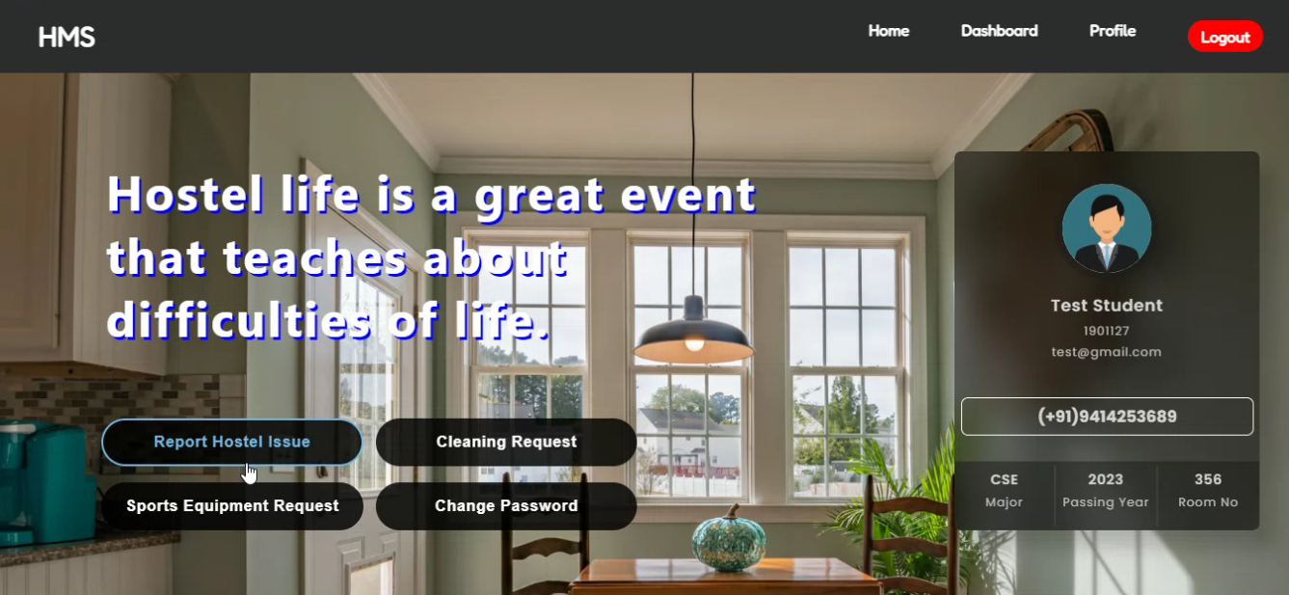

Slide 14
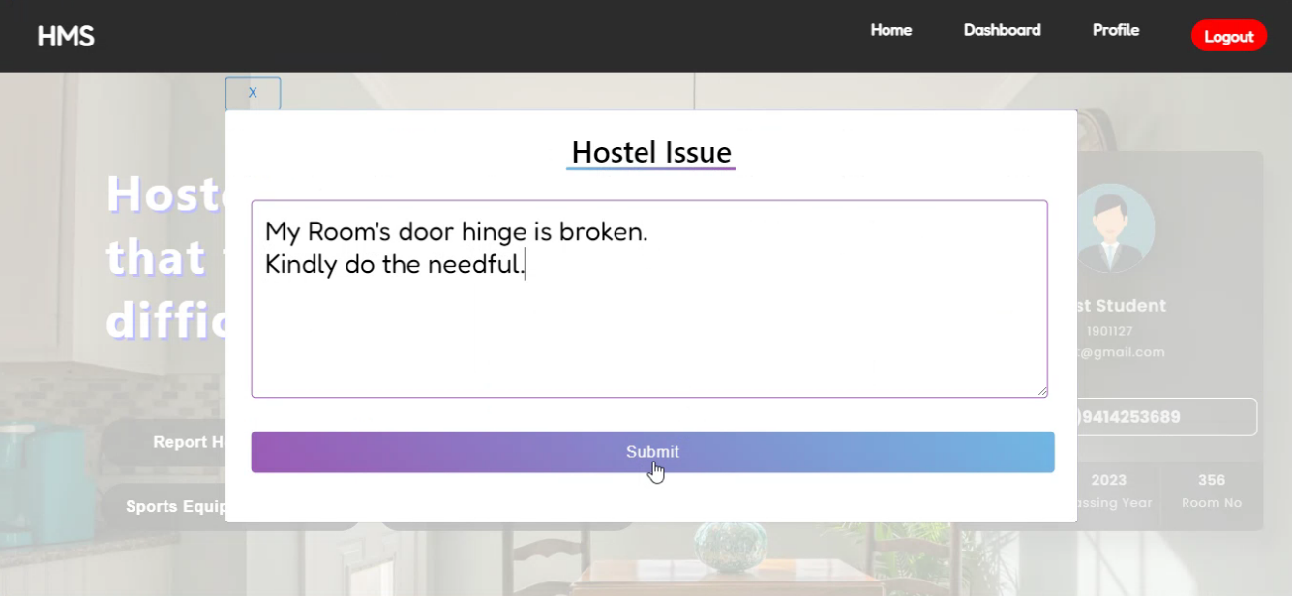

Slide 15
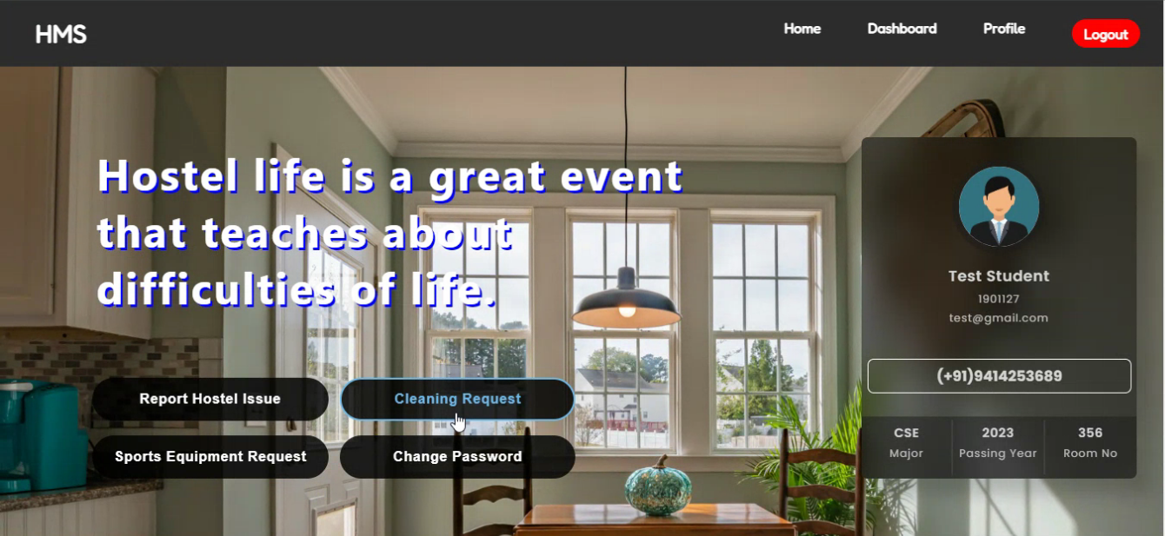

Slide 16
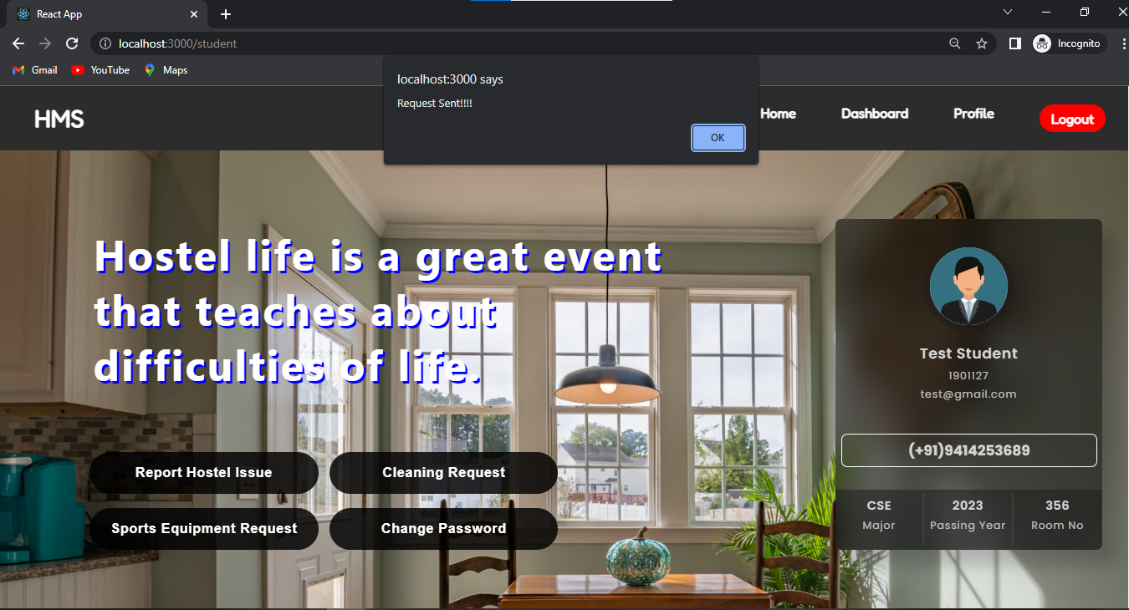

Slide 17
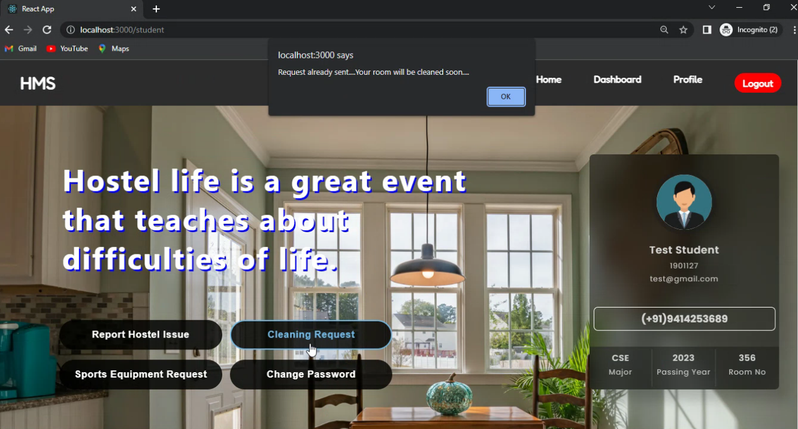

Slide 18
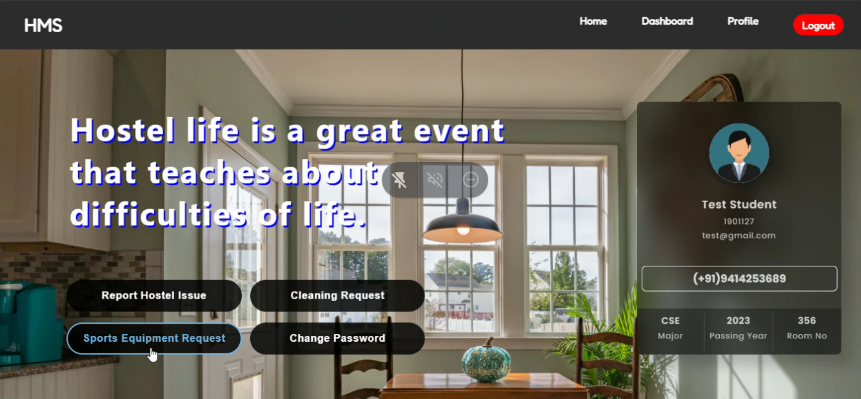

Slide 19
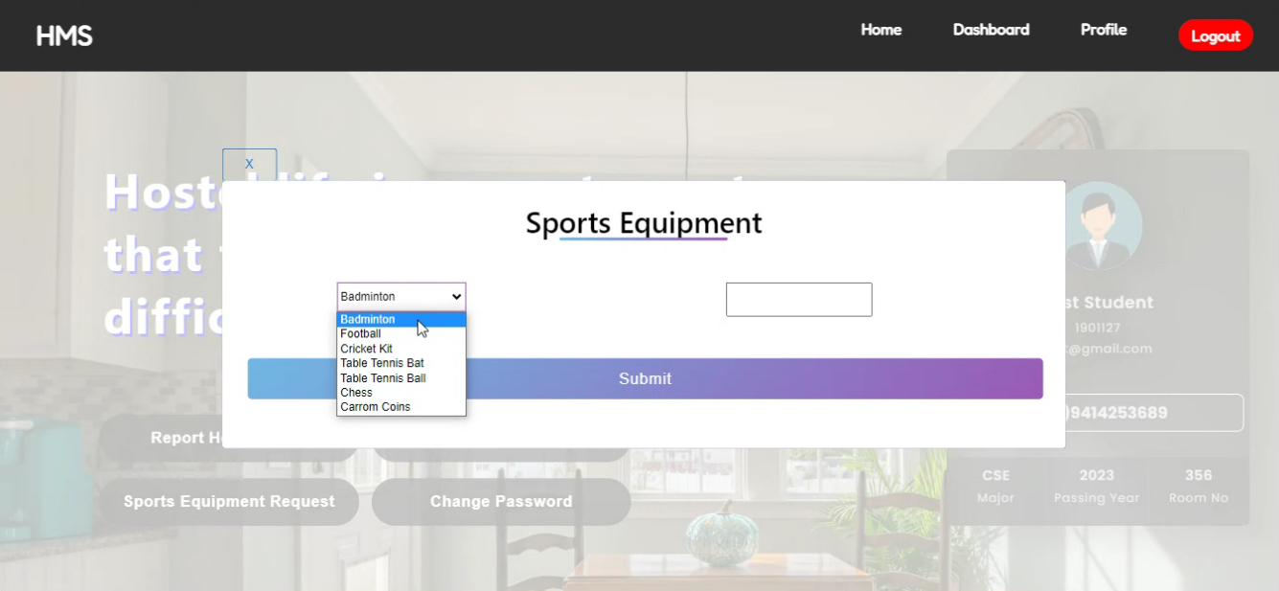

Slide 20
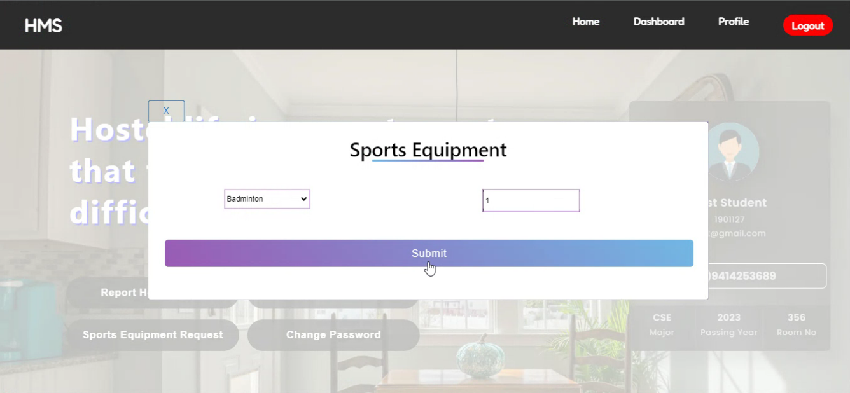

Slide 21
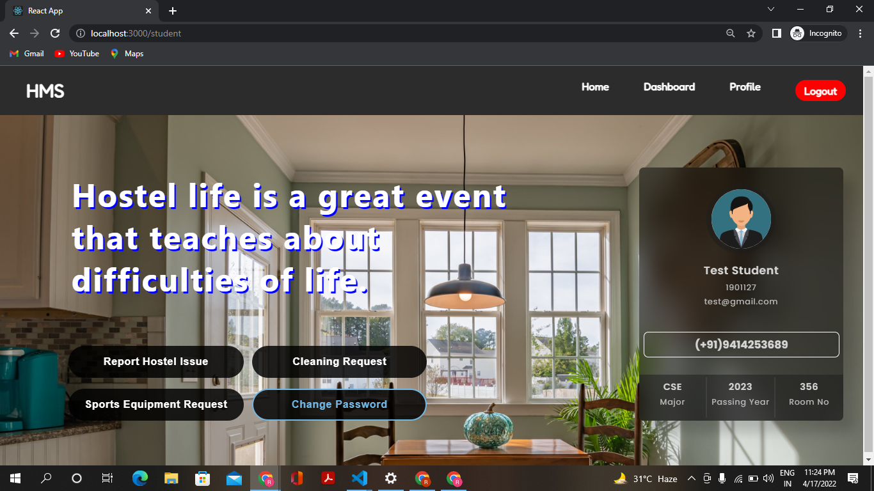

Slide 22
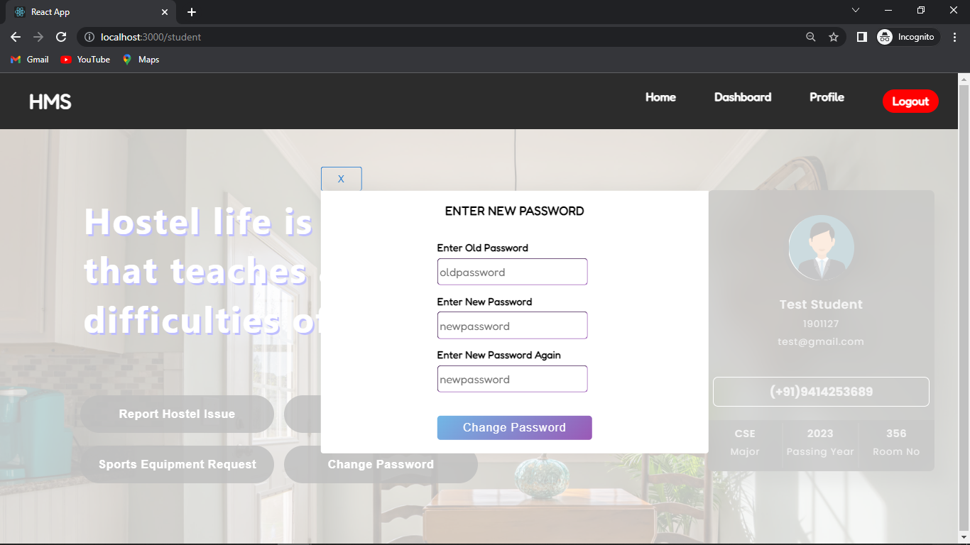

Slide 23
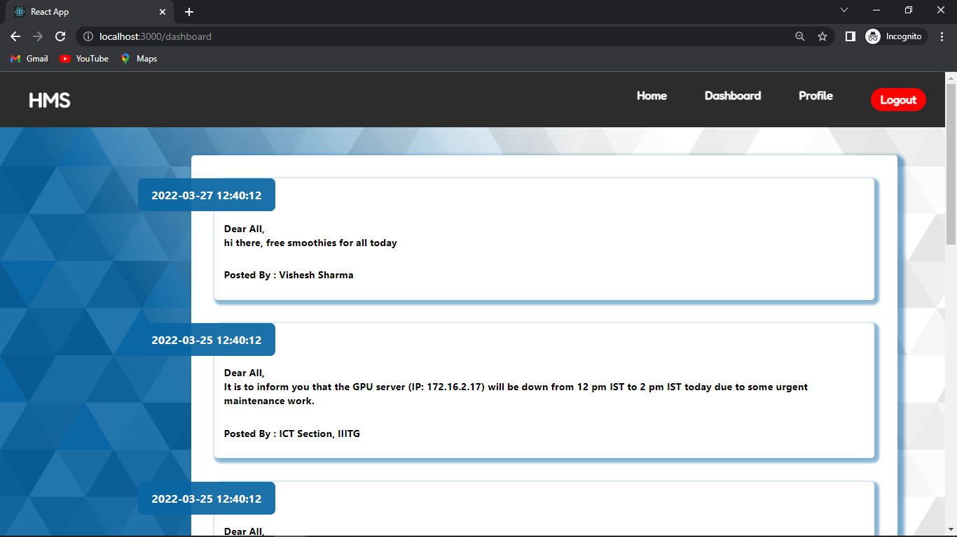

Slide 24
GUARD INTERFACE
Profile
Guard's personal information is fetched from the API call to the “guard” table.
Room Cleaning Service
Status of cleaning staff (Assigned/Not-Assigned) is fetched from the “requests” table.
Room Queries
Room Queries are fetched from the “requests” table and can be viewed by the guards on the room queries dashboard

Slide 25
Delivery Updates
New delivery can be added by the guards by filling up details in the form.
It displays the data fetched from the “delivers” collection and guards can change status of delivery to delivered when the package has been taken by the student, which is then reflected in the DB.
Sports Equipment Request
All the requests for the sports equipment by the students, fetched from the “sports” collection are displayed in the table.
Guards can accept requests when the equipments are issued to the students, which would send a POST request sending student’s UID as the issuer ID.
Close Sports Equipment Request
The issued equipments are displayed in the table which are fetched by api call to the sports collection.

Slide 26
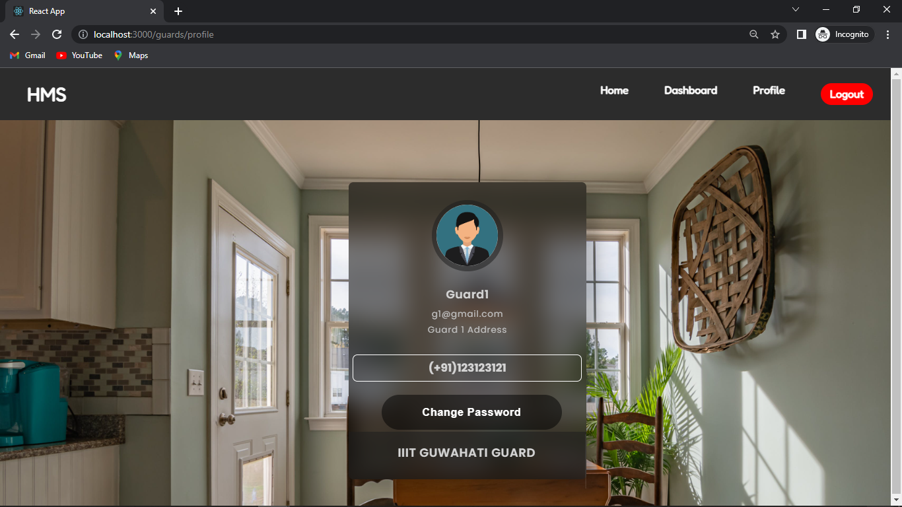

Slide 28
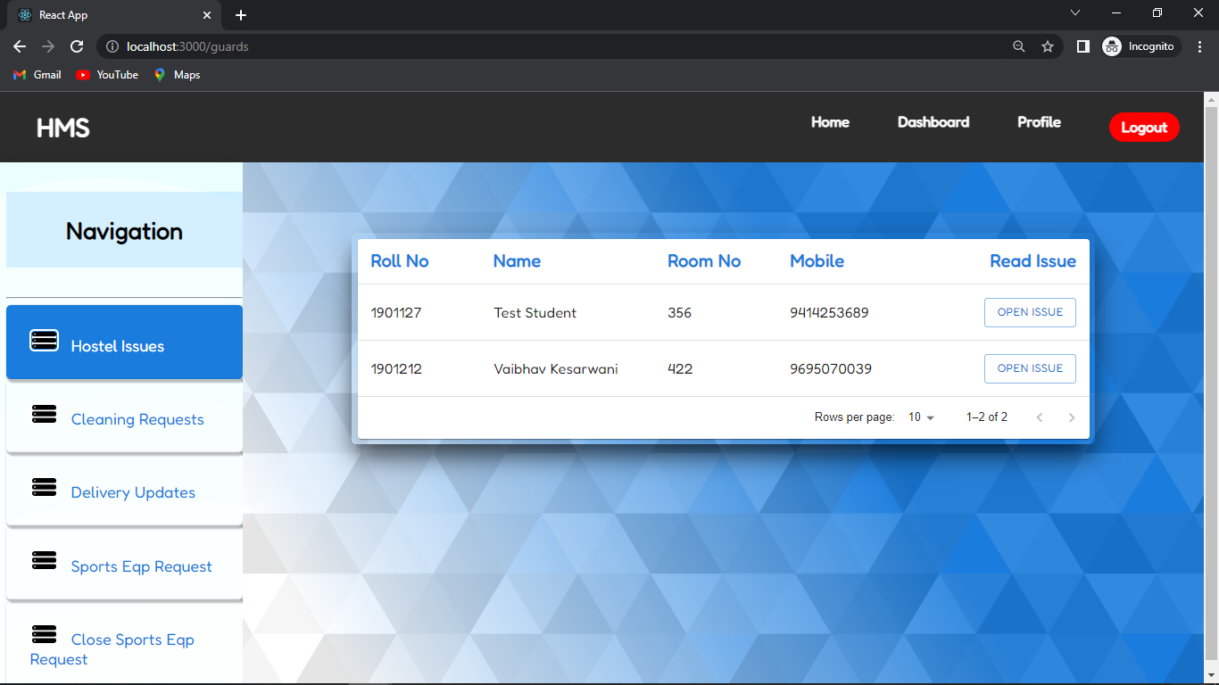

Slide 29
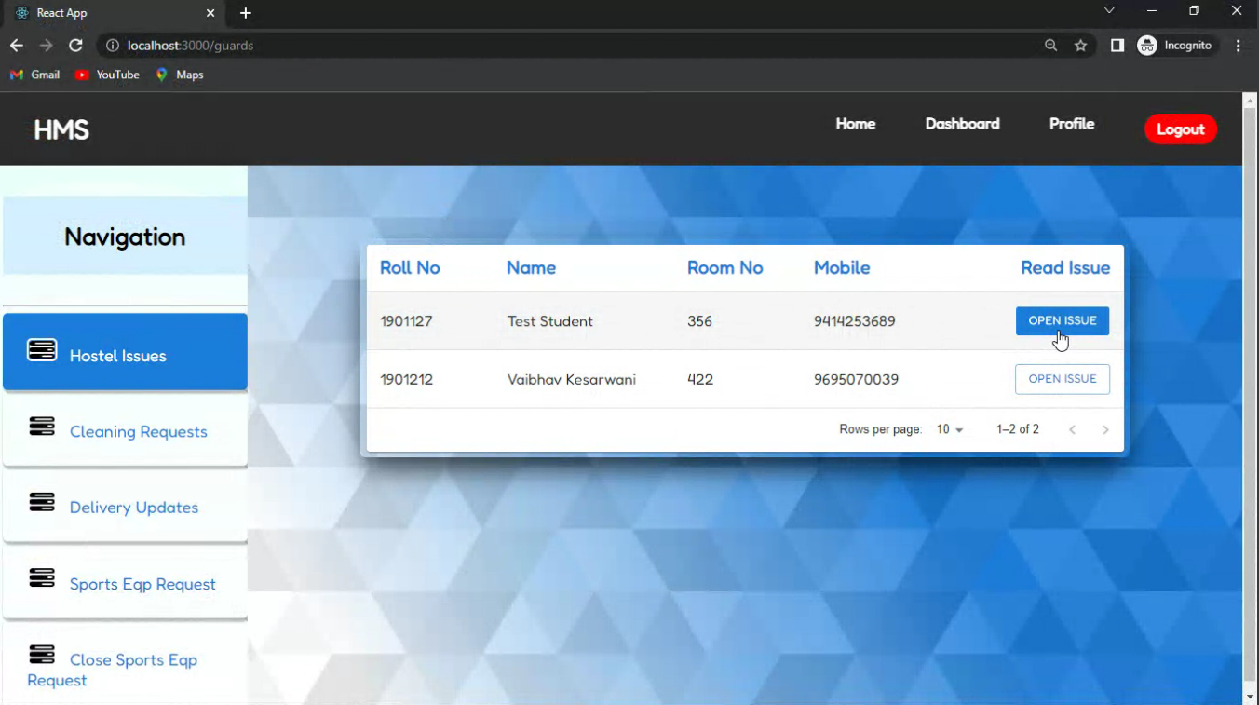

Slide 30
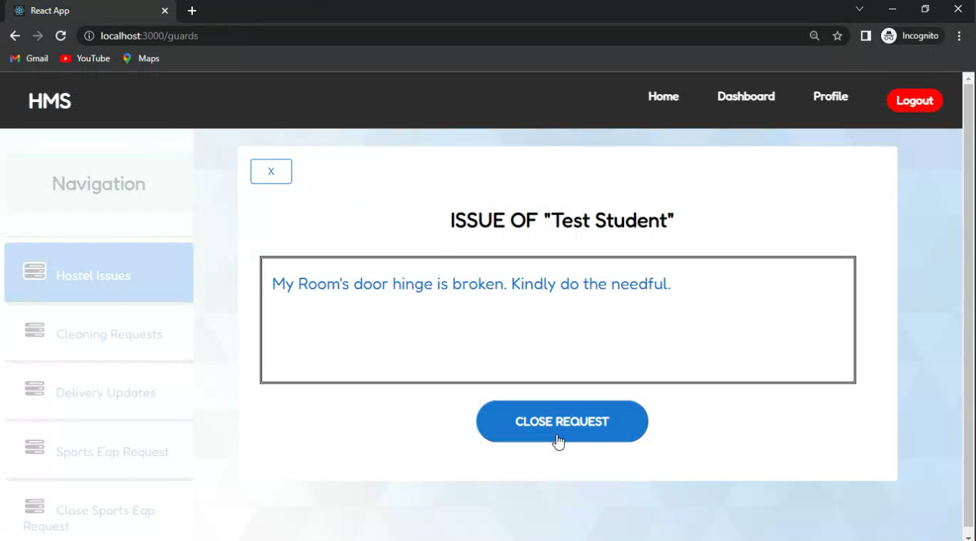

Slide 31
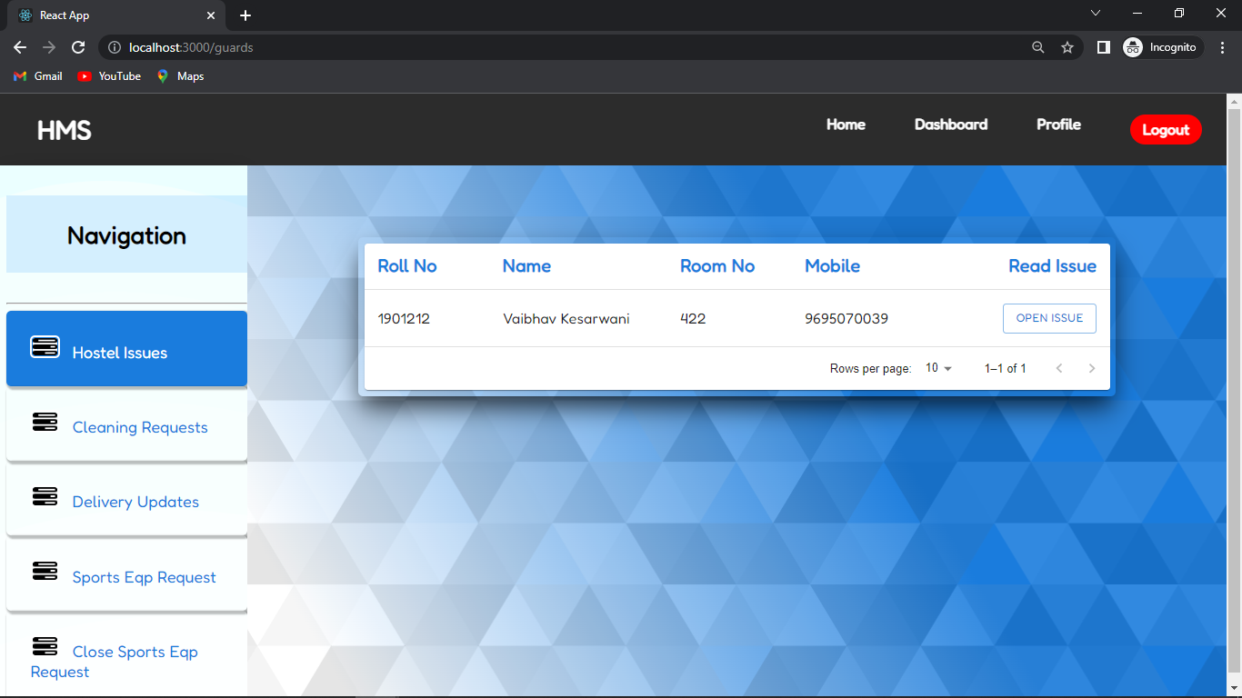

Slide 32
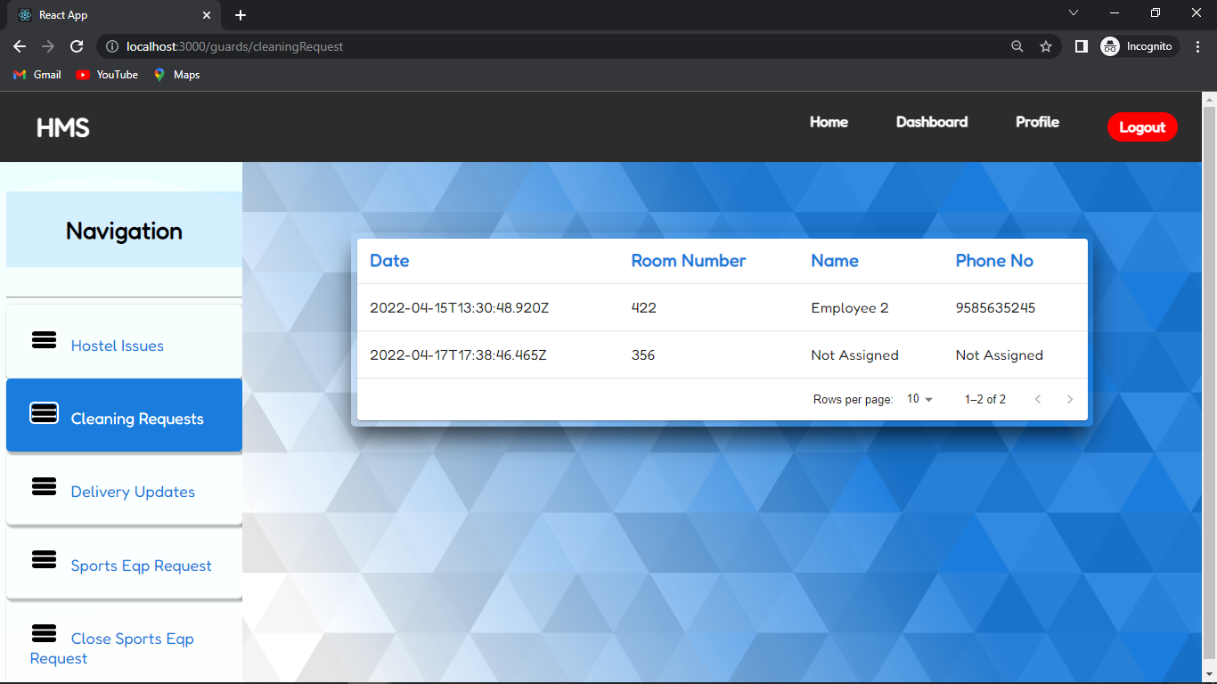

Slide 33
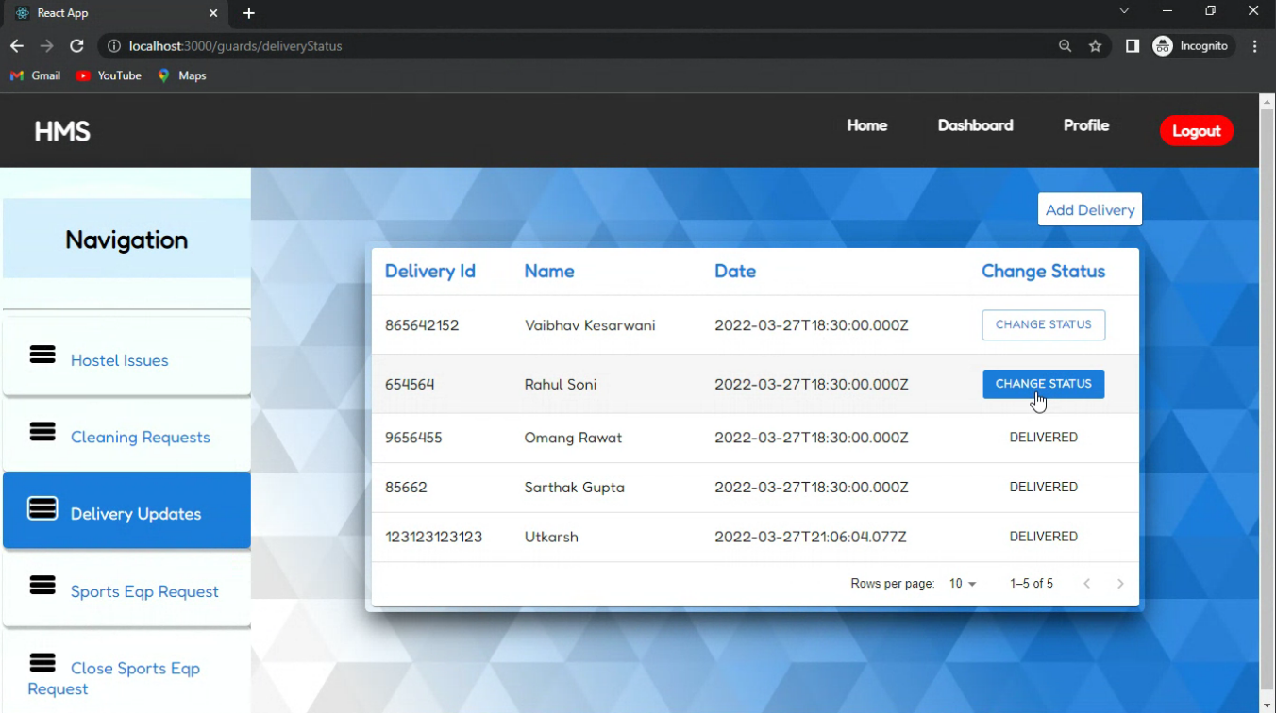

Slide 34
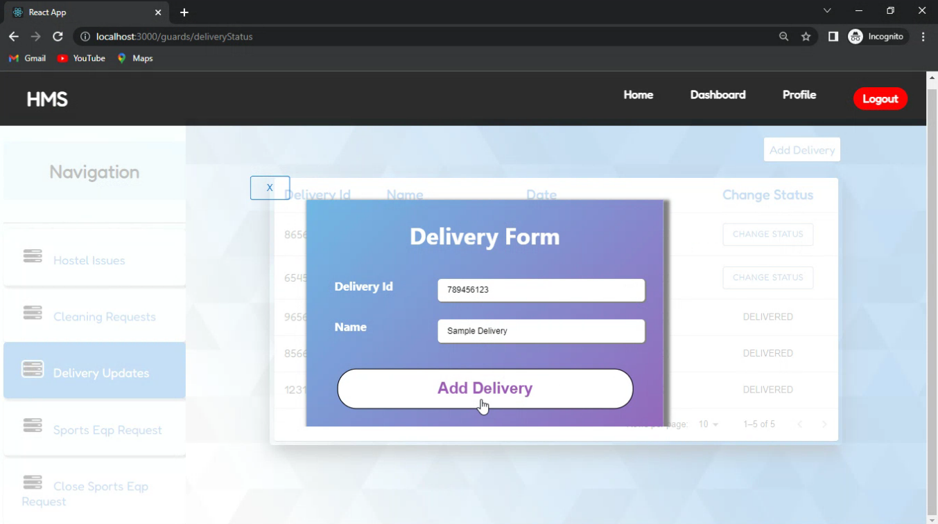

Slide 35
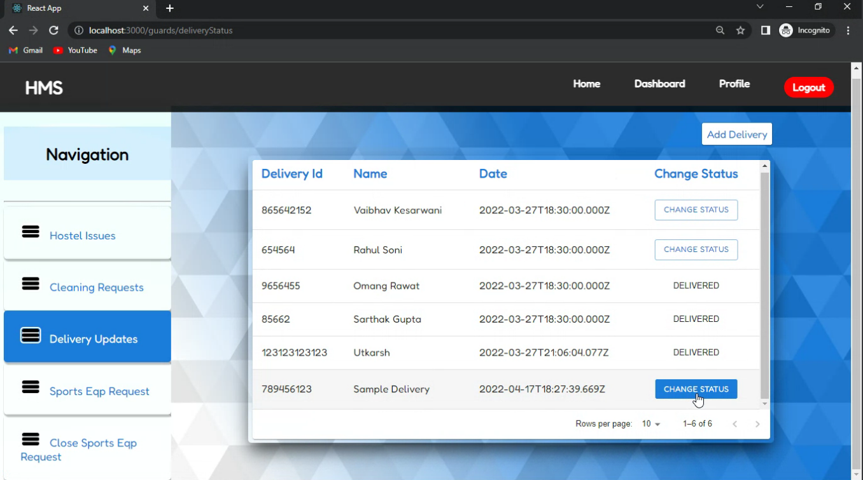

Slide 36
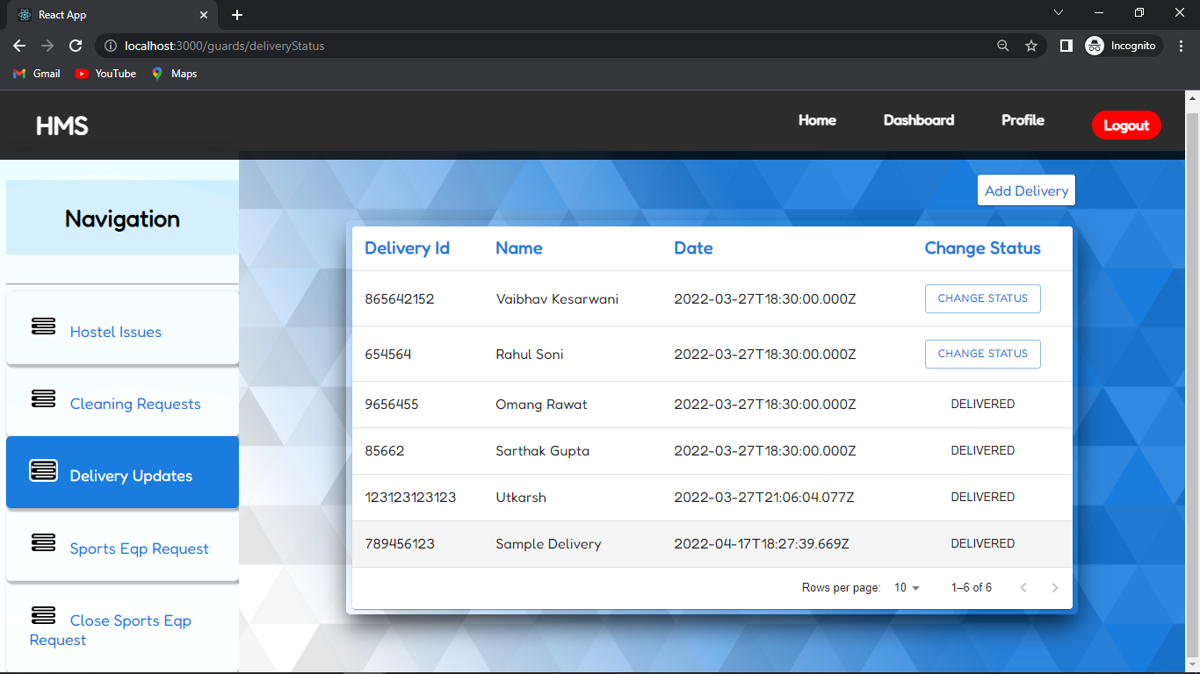

Slide 37
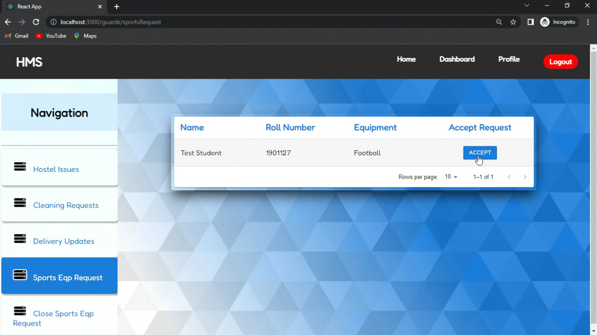

Slide 38
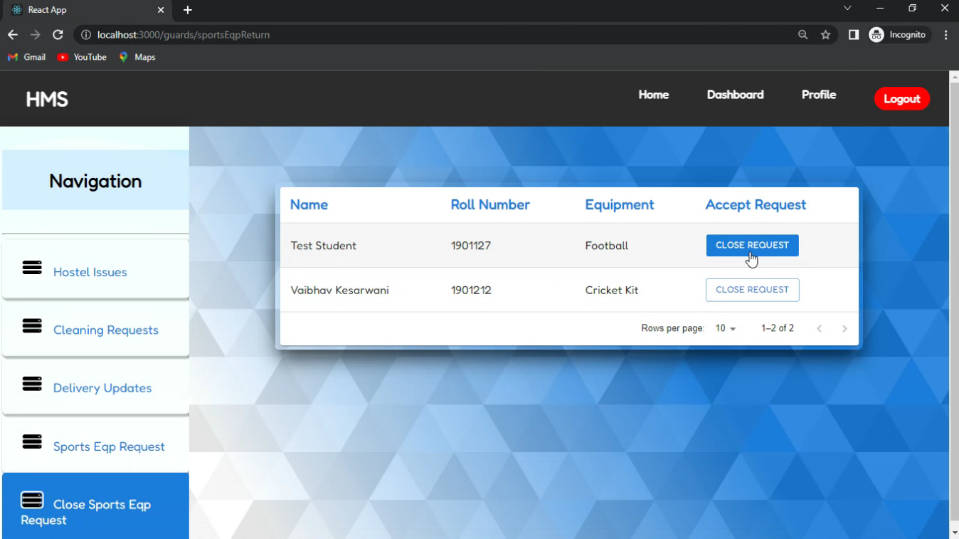

Slide 39
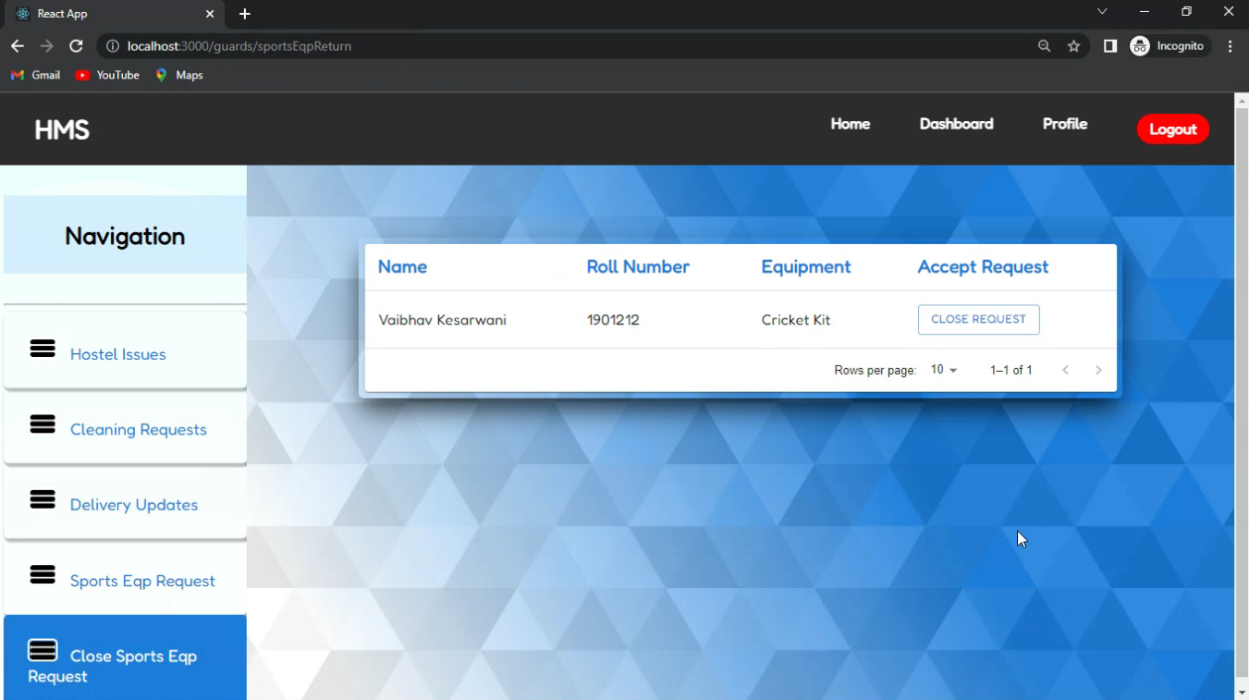

Slide 40
CLEANING SERVICE INTERFACE
Profile
Cleaning Service's personal information is fetched from the API call to the “employees” table.
Cleaning Requests
Cleaning Requests from the “requests” collection is fetched and displayed in the table.
Cleaning requests are accepted by the cleaning service according to the floors assigned to each employee.
Accepted Requests
Cleaning Requests accepted by the cleaning service is displayed in the table.
Accepted cleaning requests can marked as done after the assigned room has been cleaned.

Slide 41
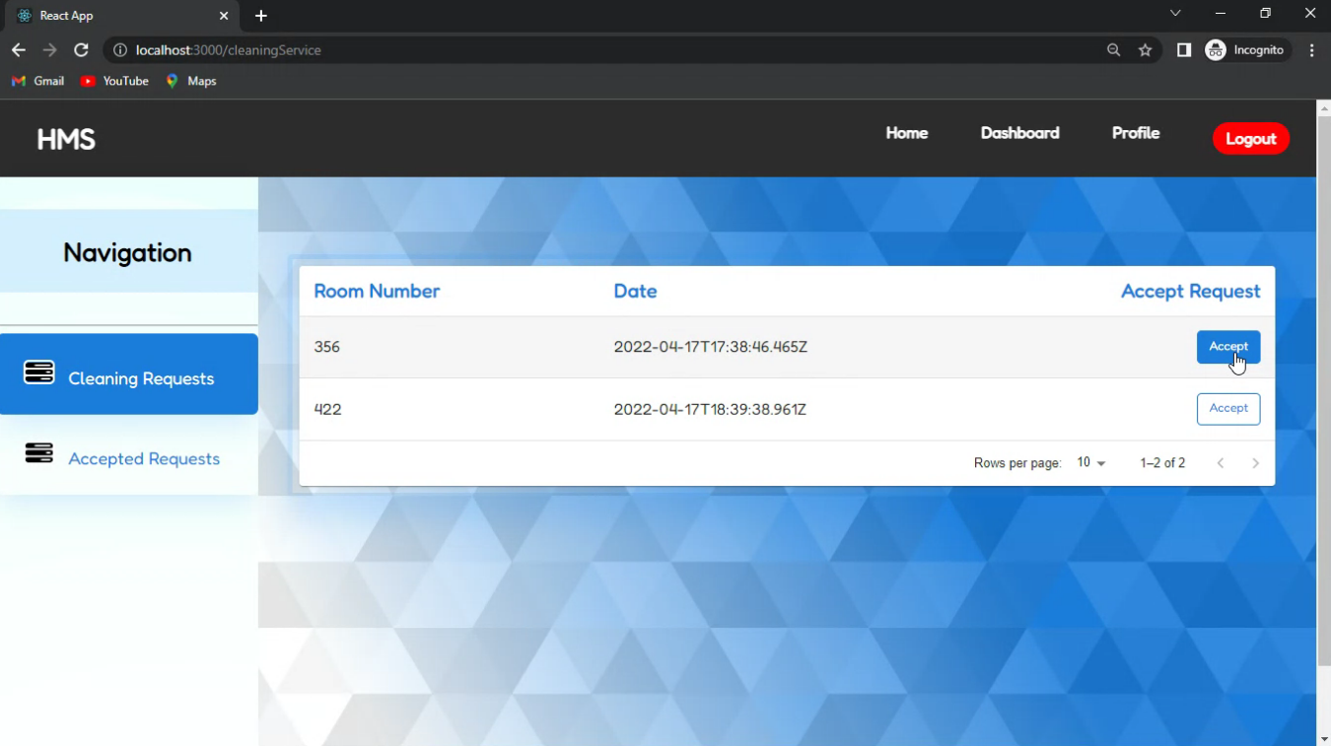

Slide 42
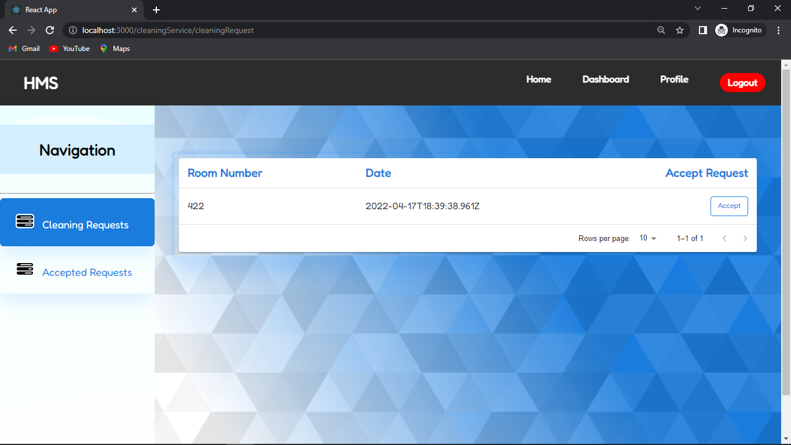

Slide 43
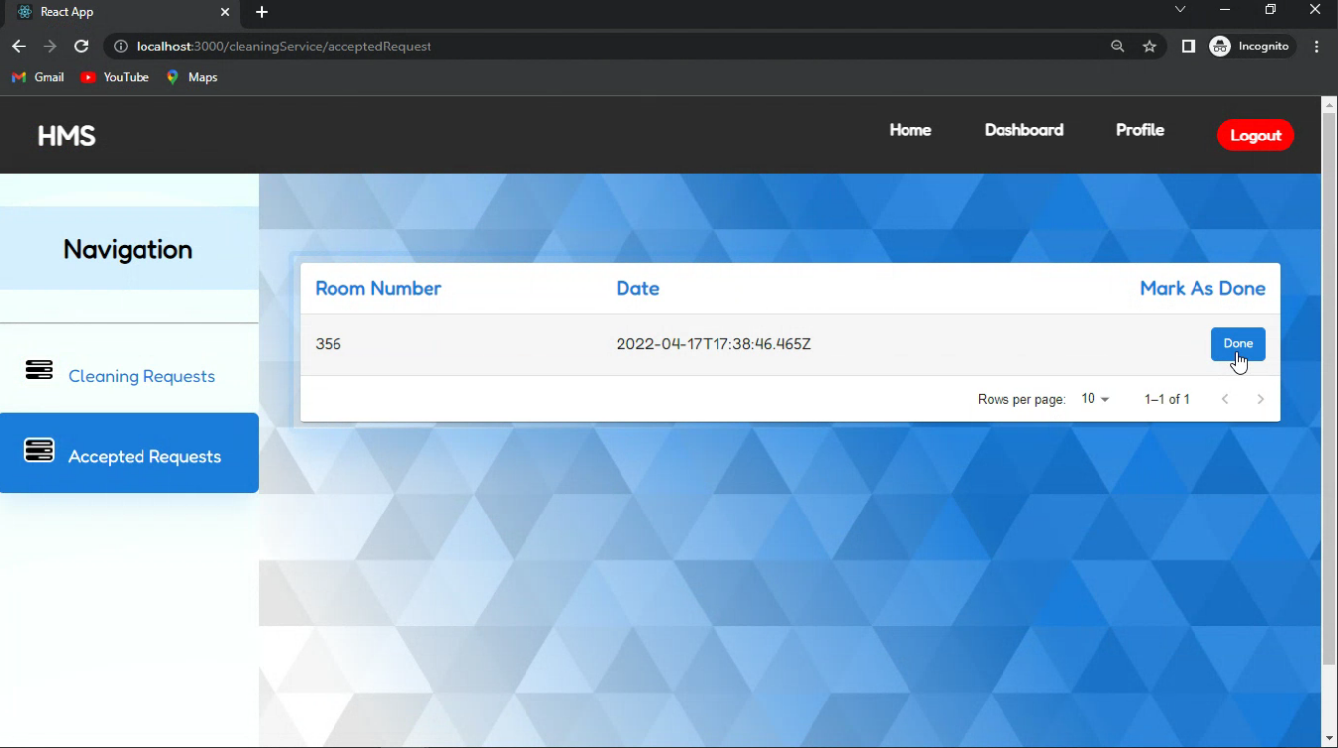

Slide 44
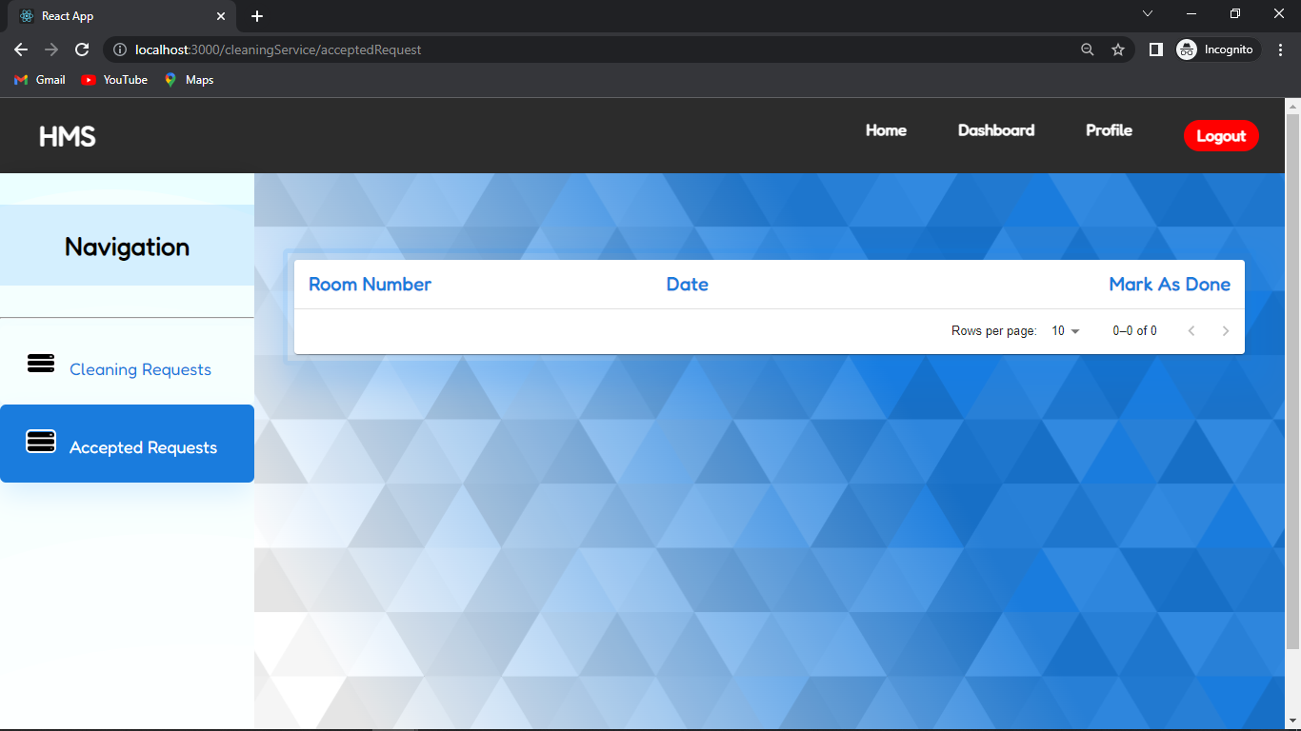

Slide 45
WARDEN INTERFACE
Profile
Warden's personal information is fetched from the API call to the “wardens” table.
Student
Student details can be added / edited / deleted by making respective POST request to the “students” collection..
All the document of the student are fetched from the “students” collection and displayed

Slide 46
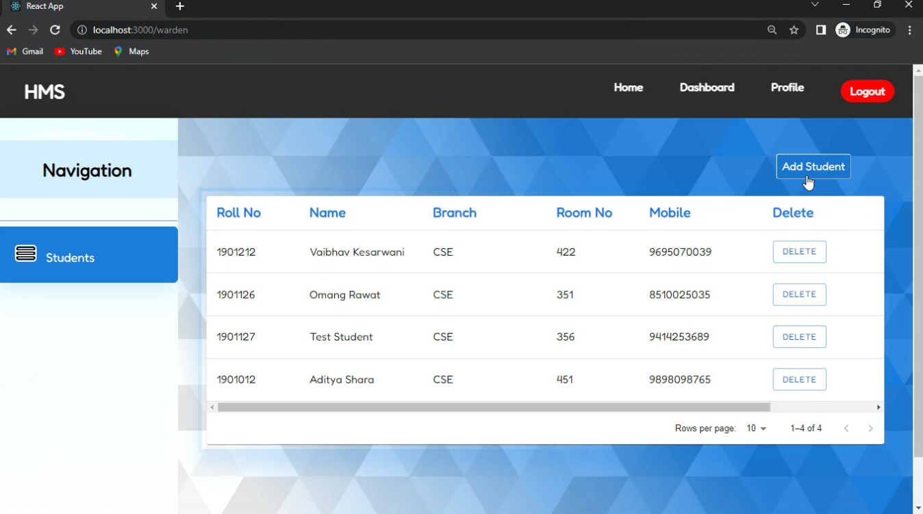

Slide 47
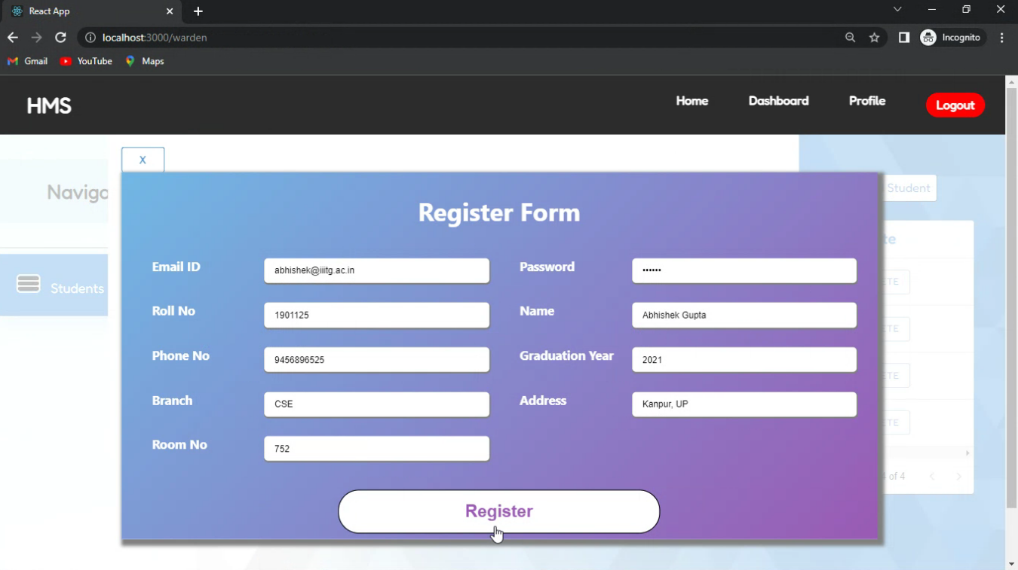

Slide 48
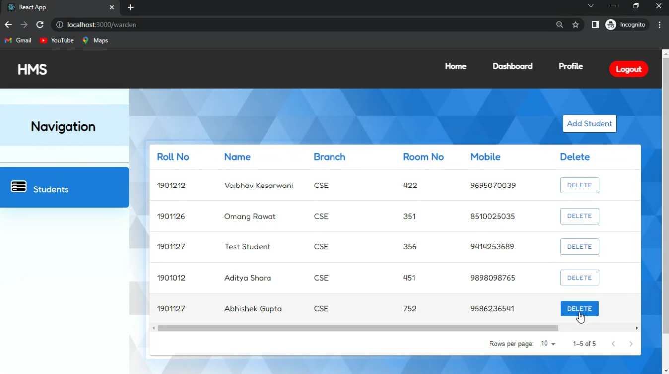

Slide 49
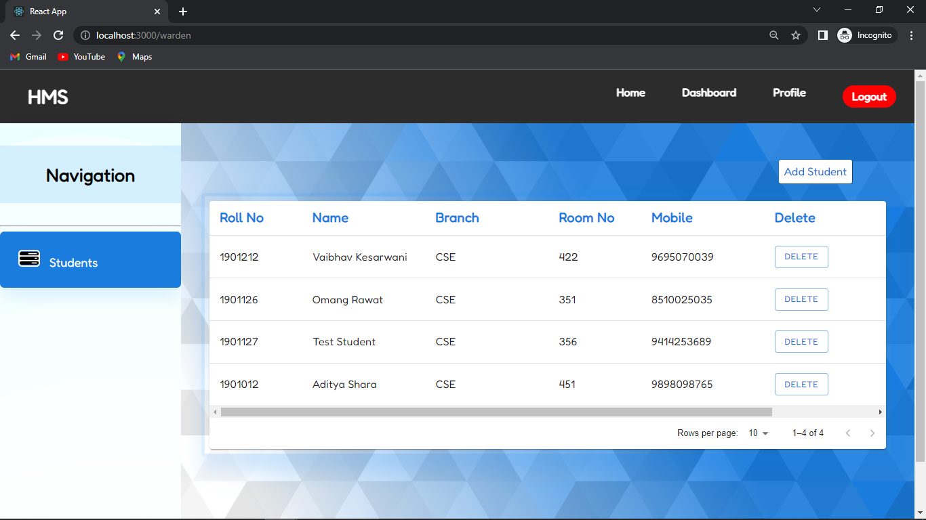

Slide 50
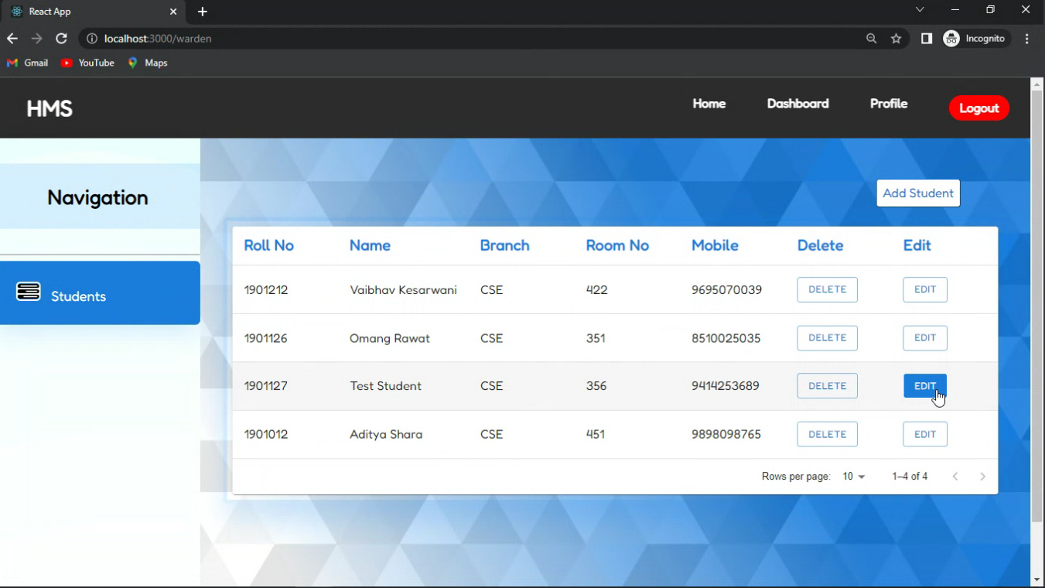

Slide 51
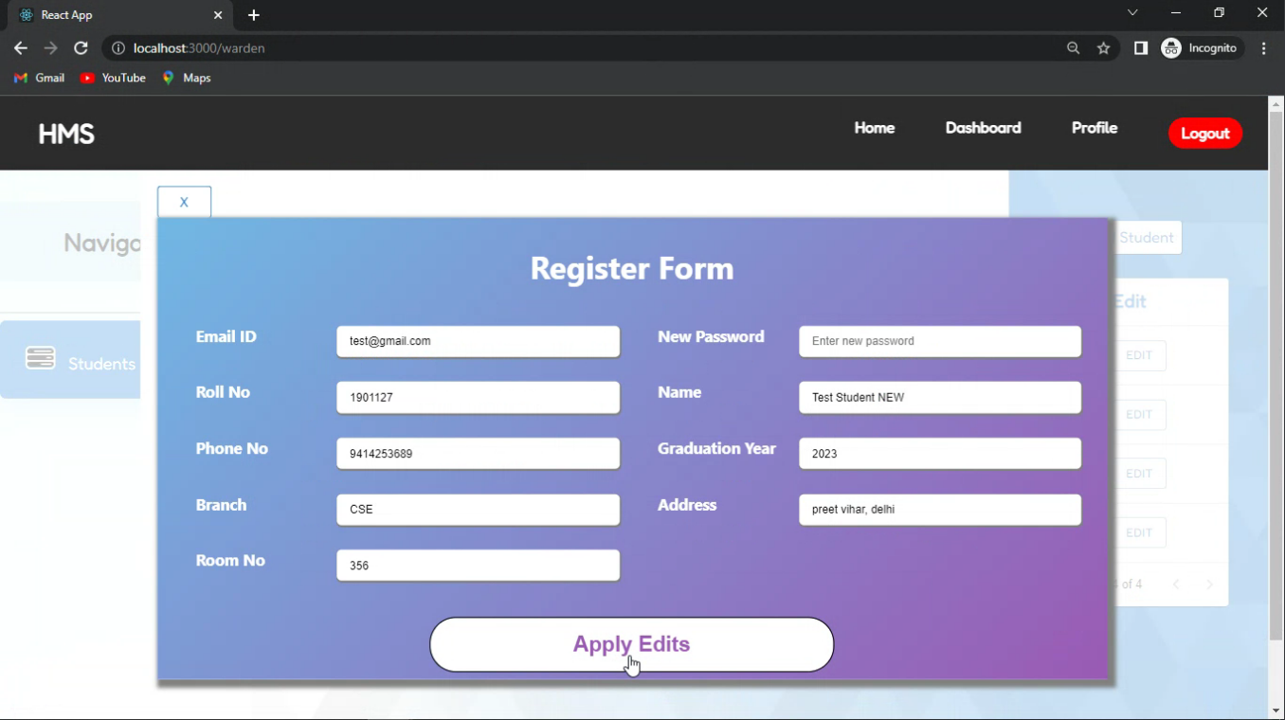

Slide 52
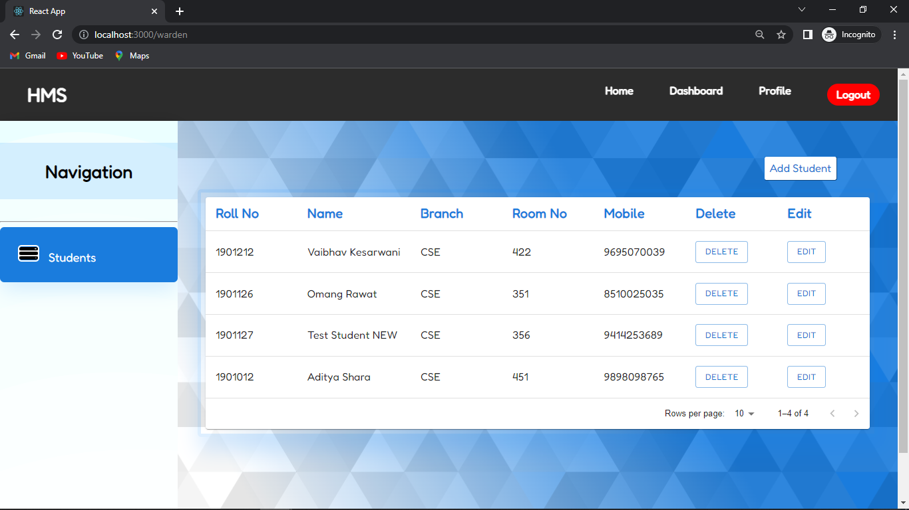

Slide 53
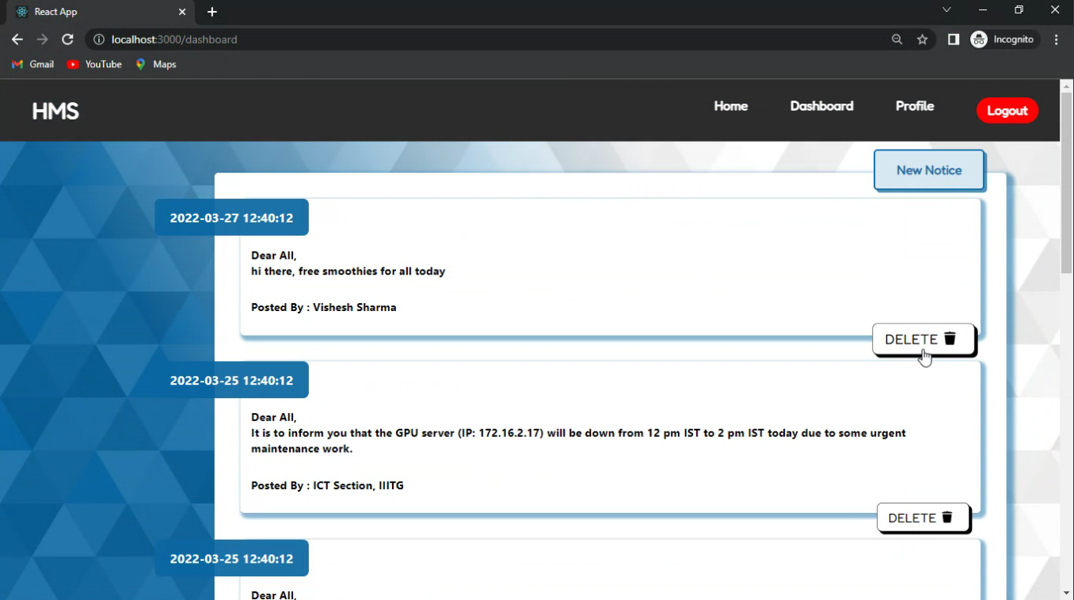

Slide 54
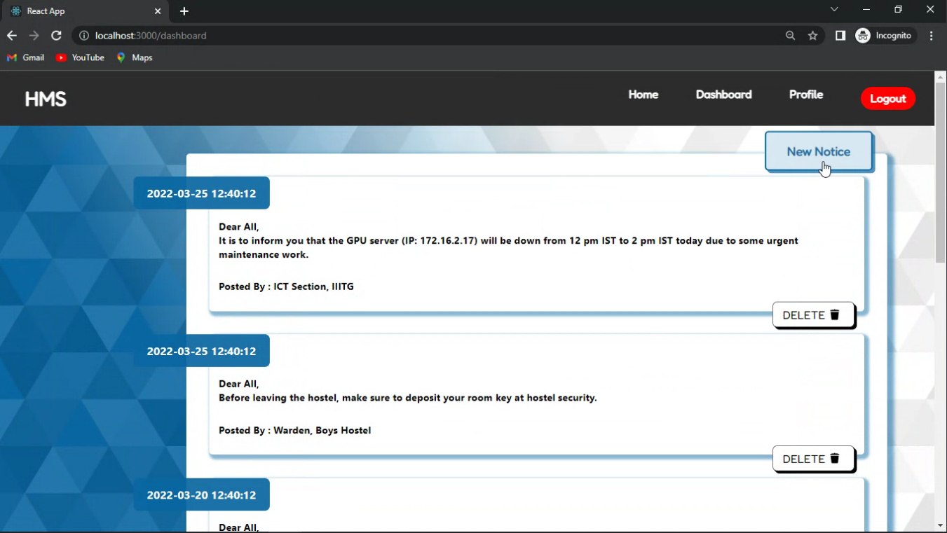

Slide 55
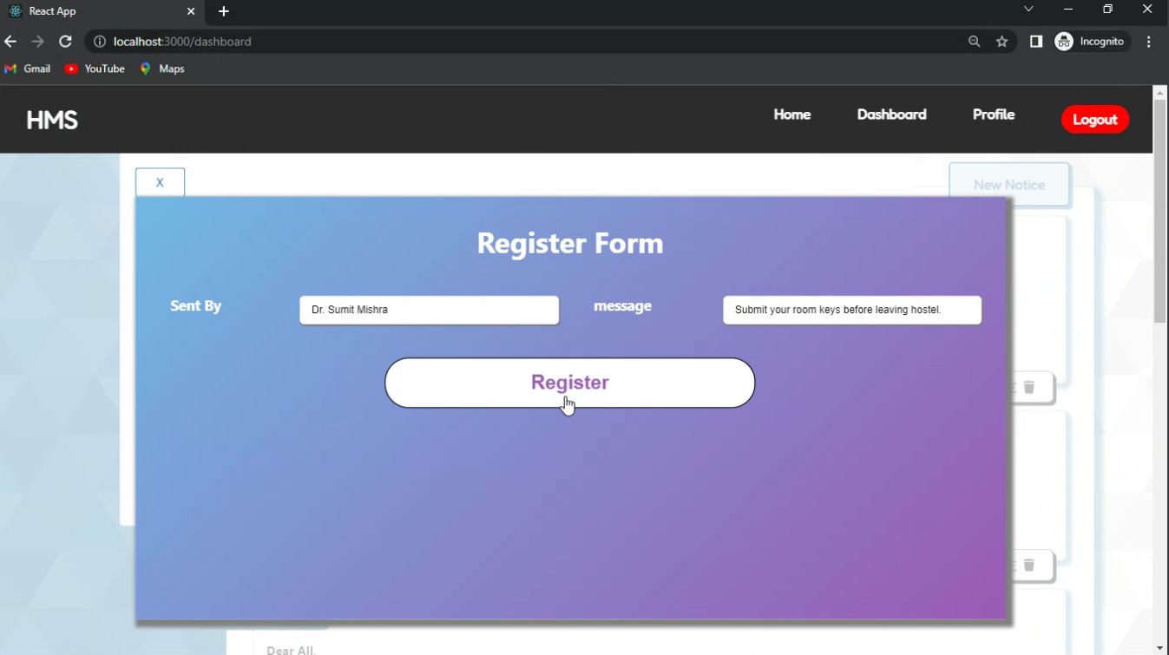

Slide 56
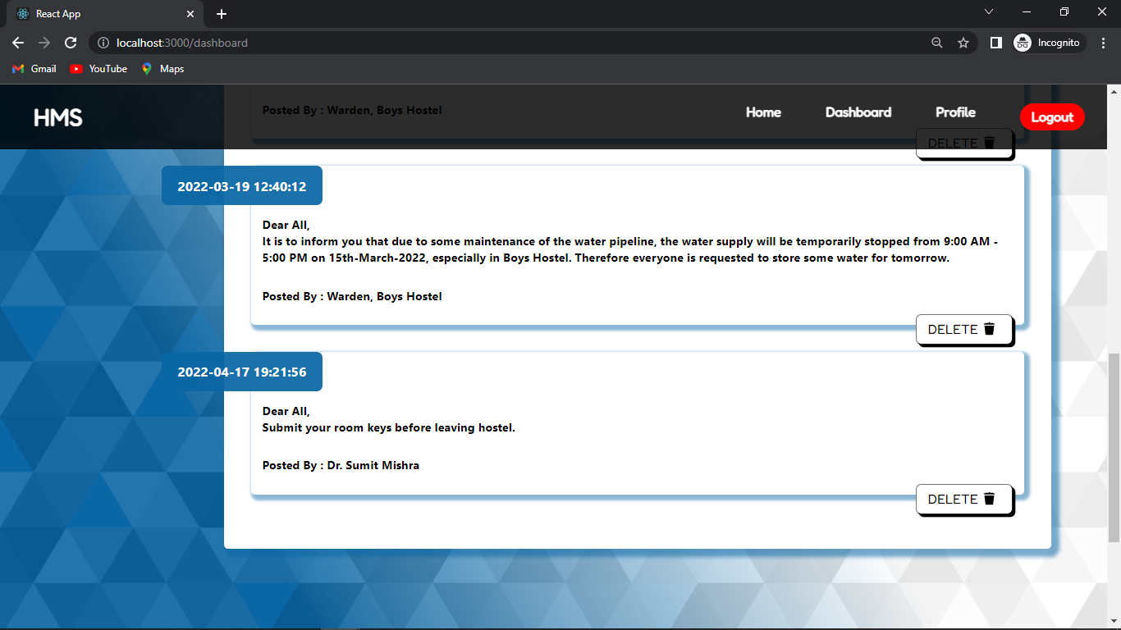

Slide 57
CARETAKER INTERFACE
Profile
Caretaker's personal information is fetched from the API call to the “caretakers” table.
Guards
Guard details can be added / edited / deleted by making respective POST request to the “guards” collection.
The documents from the “guards” collection are fetched and displayed in the table.
Cleaning Staff
Cleaning Staff details can be added / edited / deleted by making respective POST request to the “guards” collection.
The documents from the “employees” collection are fetched and displayed on the dashboard.

Slide 58
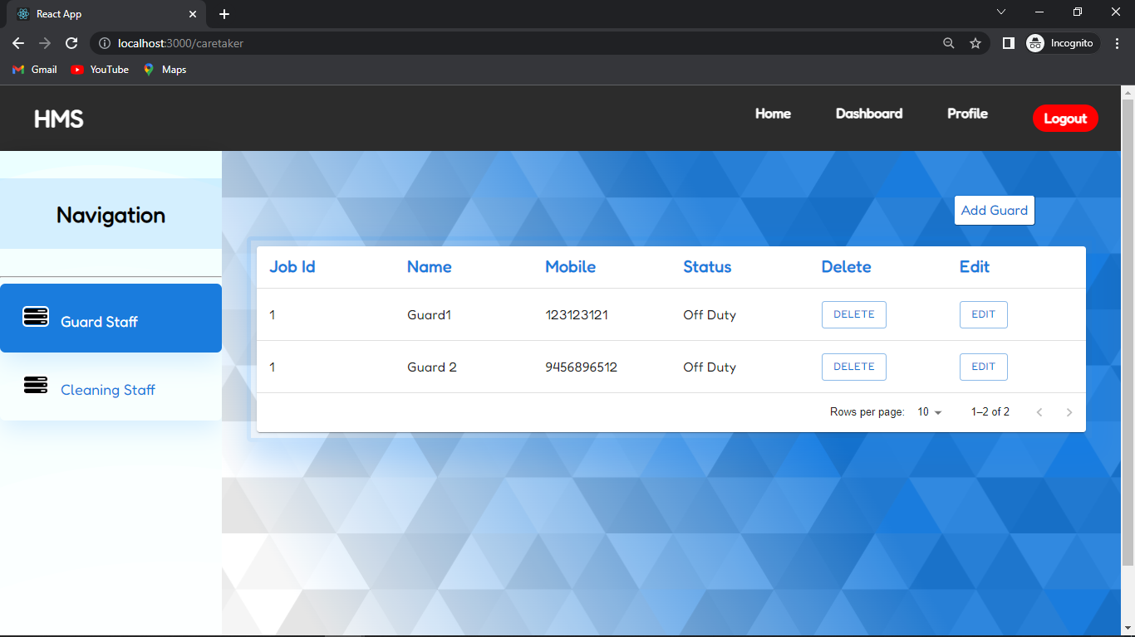

Slide 59
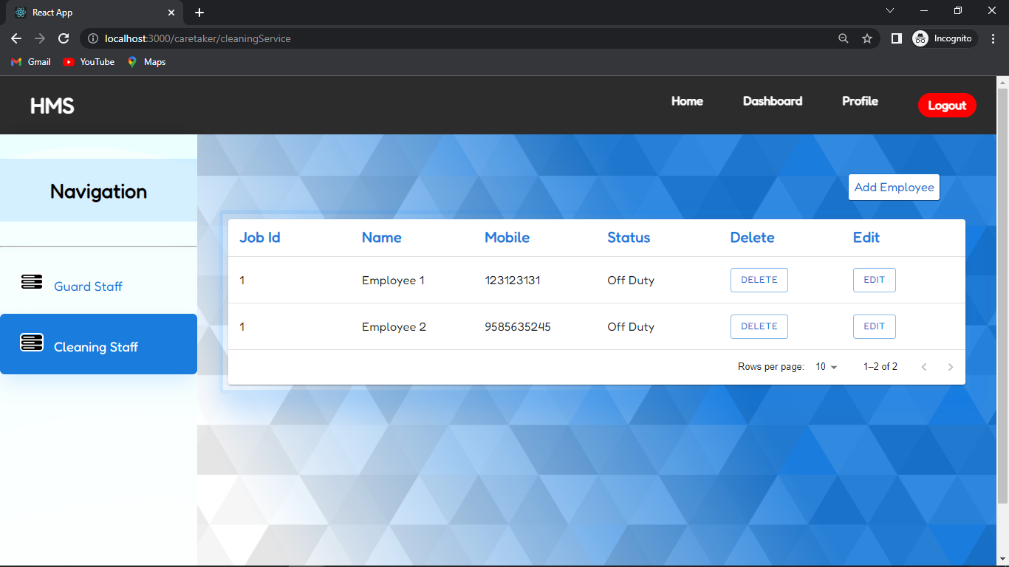

Slide 60
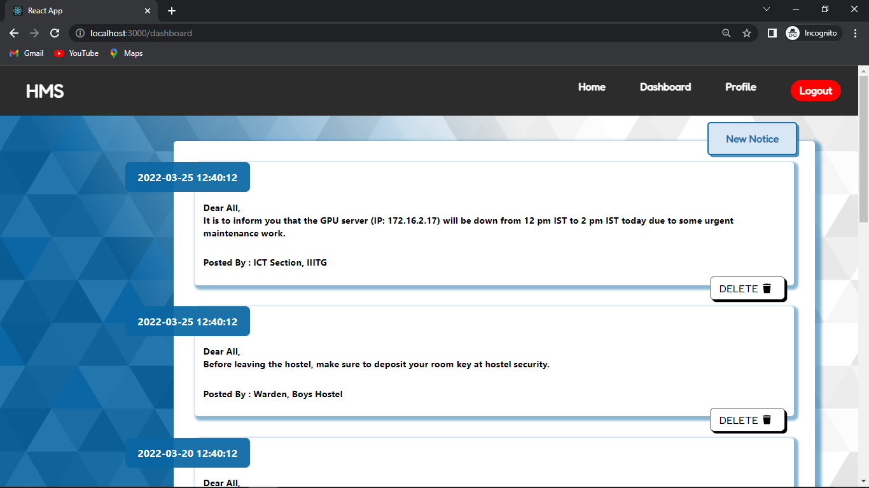

Slide 61
Validation

Slide 62
HASHING and SALTING
A “Hash” is a one-way function that generates a representation of the password.So when a user signs up for an account and they choose a password, the password is stored as the generated hash, rather than the actual characters that the user typed in.
Unfortunately, hashing a password is not nearly enough
In order to make it more difficult to expose a hash, you also need to salt it. Salting is where you add an extra bit of data to the password before you hash it.
Salting is important because it adds a whole new level of required computational power in order to expose the hash. By adding a salt, you effectively render any lookup table useless. Hashing a password is not 100% secure as hashing alone is not that difficult to break. When you add a salt to the hash, you make it much more difficult to crack.

Slide 63
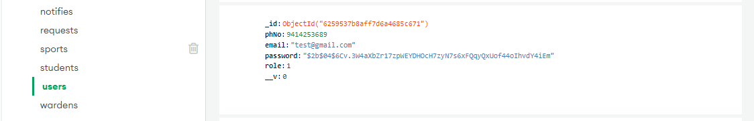
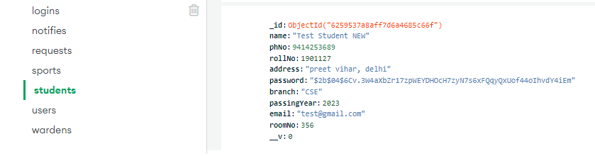

Slide 64
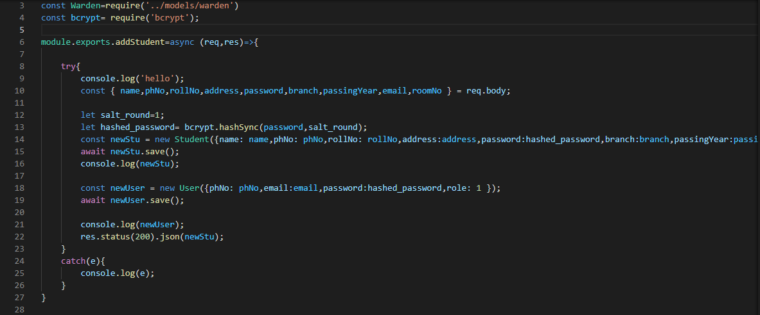
Code Snippet of hashing and salting

Slide 65
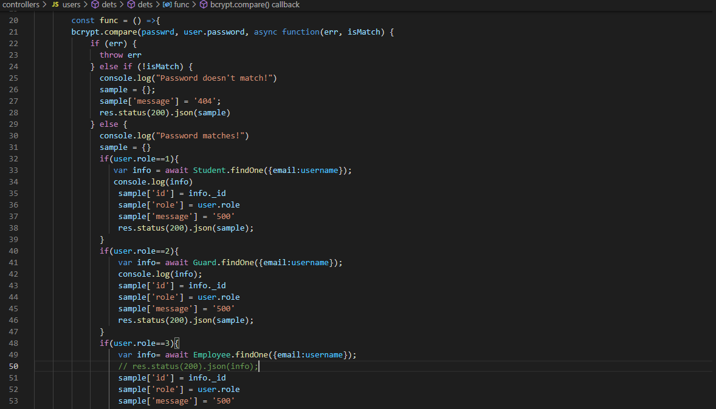
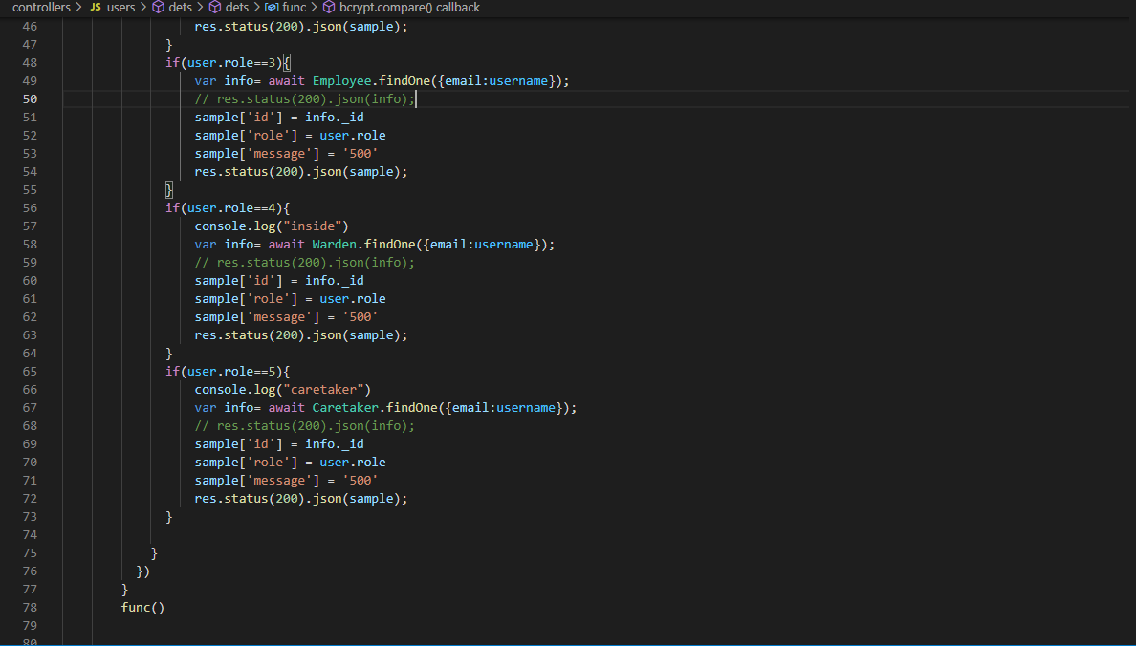
ROLES AUTHORIZATION

Slide 66
MVC Pattern
View
Controller
Model
MVC Pattern stands for Model-View-Controller Pattern. This pattern is used to separate application's concerns.
Represents the visualization of the data that model contains.
Acts on both model and view. It controls the data flow into model object and updates the view whenever data changes. It keeps view and model separate.
Represents an object carrying data. It can also have logic to update controller if its data changes

Slide 67
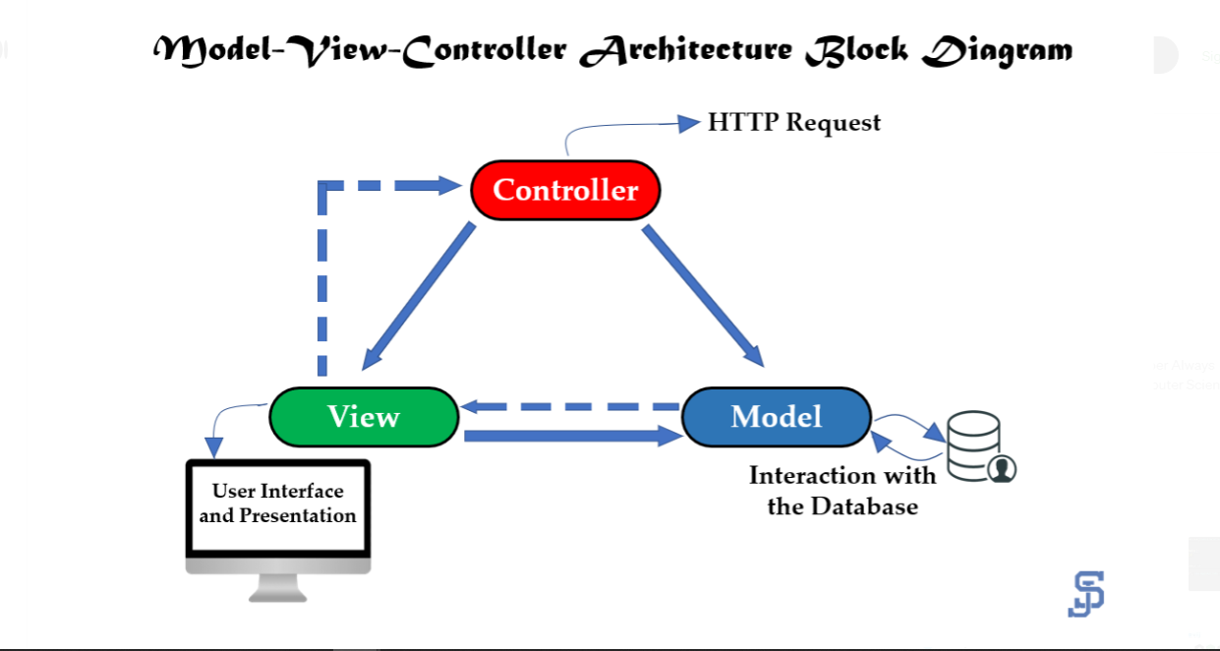

Slide 68
CRUD IMPLEMENTATION
Student, Guard and Cleaning Staff can Read the updates on dashboard.
Warden and Caretaker can Create, Read or Delete updates on dashboard.

Slide 69
SCHEMAS
A schema is a JSON object that defines the the structure and contents of your data.
Schemas represent types of data rather than specific values. There are many built-in schema types. These include primitives, like strings and numbers, as well as structural types, like objects and arrays, which you can combine to create schemas that represent custom object types.
In our project we have used 11 schemas. Namely: user, student, warden, caretaker, guard, employee, delivery. Sports and notify, request, dashbo
Some of them are shown below

Slide 70
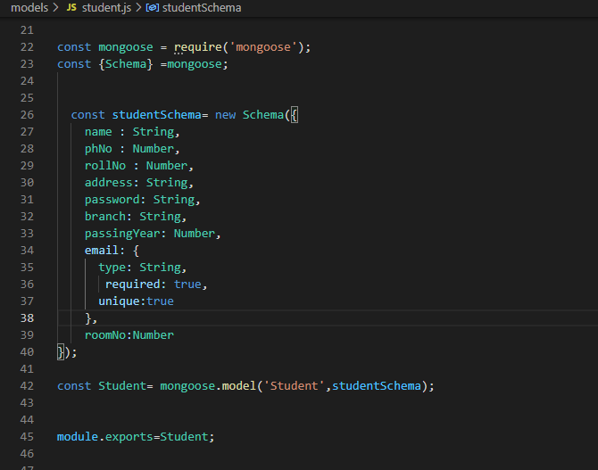


Slide 71
CONTRIBUTION
Omang Rawat (1901126)
Implemented Login and Dashboard components.
Created Student and Caretaker Interface
Handled function calls (REST API)
Managed dataflow between different components.
Rahul Soni (1901154)
Created Guard, Cleaning Service, Warden Interface
Adding CRUD implementation. (Frontend)
User Authentication and Authorization (Frontend)
Hashing and Salting

Slide 72
CONTRIBUTION
Vaibhav Kesarwani (1901212)
Implemented Profile Interface
MongoDB Setup , Populating and managing data
Unit Testing for backend (Using Mocha and chai)
Integration Testing and System testing (Black box testing)
Finalizing Testing Report
Vishesh Sharma (1901217)
Created data models and schemas
User Authentication and Authorization (Backend)
Created API Routes and Controllers.
Adding CRUD implementation. (Backend)

Slide 73
THANK YOU!

